Slide 1

Federal Reserve Policy Analysis
By:Gori Devi, Lindsey Metz, Matthew Zimmer, Vincent Marzano & William McFarland
Professor Bonini
Bt 440: Money, Banking Credit, and Financial Institutions
6 December 2016

Slide 2

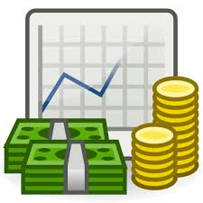
Overview
Federal Reserve’s Policy Target
Data Analysis of Key Economic Indicators
Monetary Tools Being Used
Conclusion
Lindsey Metz
Notes:
Lindsey

Slide 3
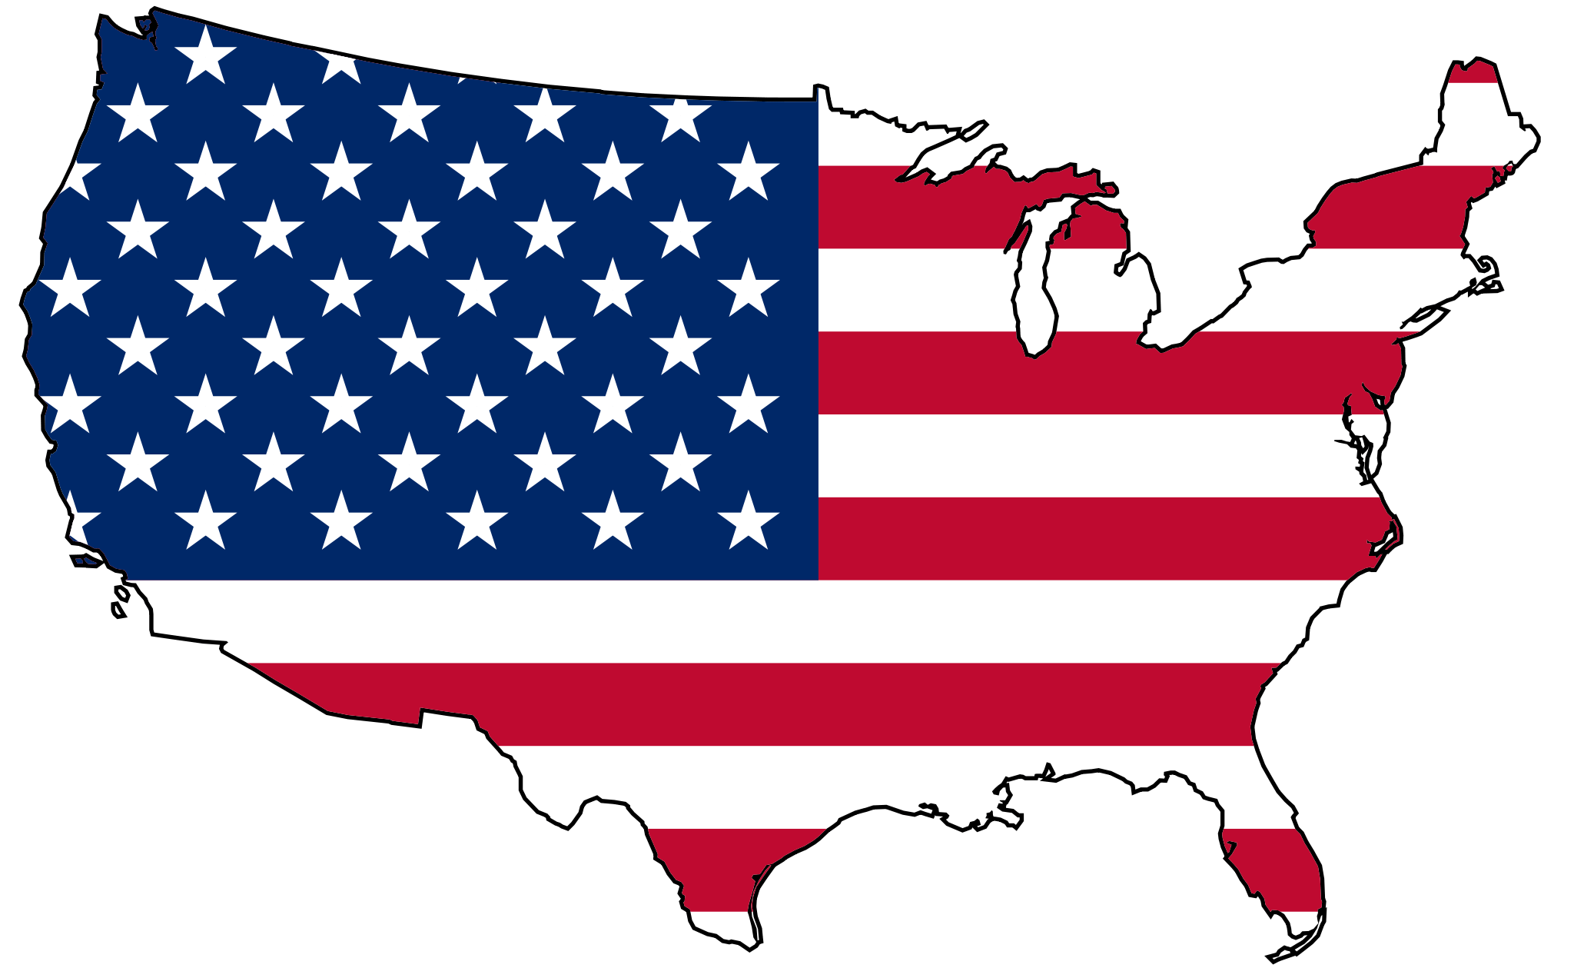
Policy Target
Create a policy which addresses economic growth problems domestically
Increase the growth of the US economic recovery since this recession recovery has been the slowest since the Great Depression
Lindsey Metz
Notes:
Lindsey

Slide 4
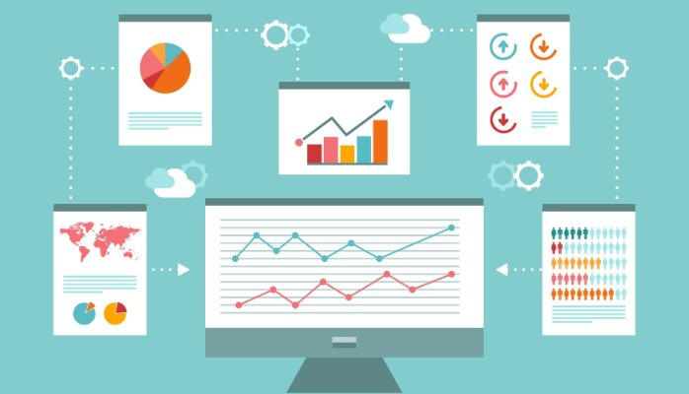
Data Analysis

Slide 5

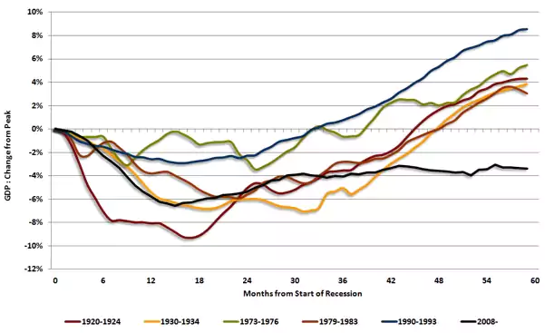
Post 2008 Recovery
Compares the post recession change in GDP from it peak for a 4 year period for major US recessions
The 2008 Great Recession has:
Drop in GDP on par with the Great Depression
The slowest GDP recovery in history
Created long term stagnation in economic growth for the US from 2008-2010
Followed by Europe’s economic recession
Lindsey Metz
Notes:
Lindsey

Slide 6
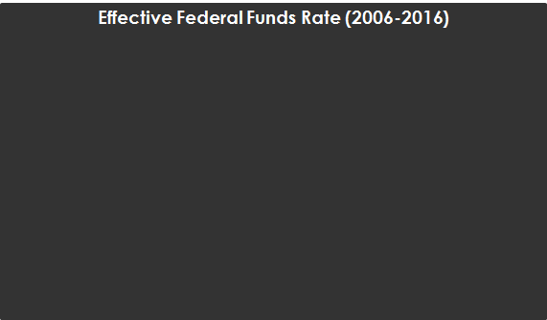
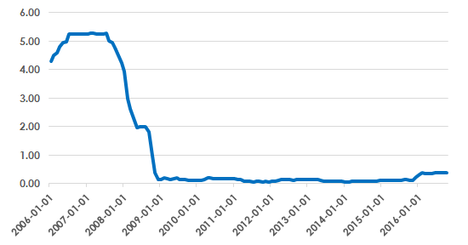
Federal Fund Rate
The federal funds rate is the interest rate at which depository institutions trade funds held at the Federal Reverse with each other overnight. Essentially, if a bank has excess reserves, it will lend the cash to another bank that needs to quickly raise its liquidity. The rate is the weighted average rate for all of these types of negotiations with some influence from the Federal Open Market Committee.
WSJ Economic Forecasting Survey
GDP (Annual)
Gori Devi
Notes:
Federal Fund Rate: he FOMC has maintained the target range for the federal funds rate at a record low of 0% to 0.25%
Time to raise rates:
The S&P 500 is just shy of its all-time high and the purchase-only index for U.S. real estate prices is at a record.
The unemployment is decreasing, home ownership is up, which well go more in depth later. So
It is time for FFR to increase.
The value of assets in securities and the stock market are over inflated and it is time to cool it down.

Slide 7
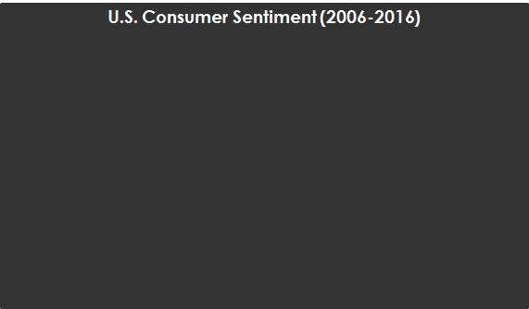
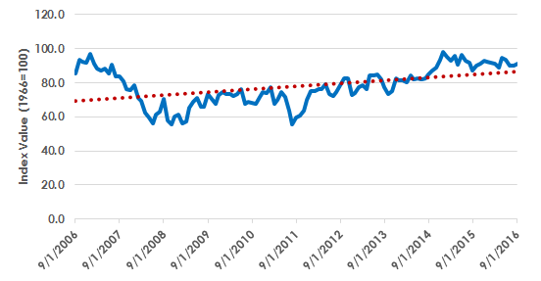
Consumer Sentiment Analysis
We are using the University of Michigan’s U.S. Consumer Sentiment Index (MSCI). The Survey Research Center collects over 500 phone surveys monthly to gather information on consumer expectations regarding the overall economy (base year is 1966 equal to 100 points).
When consumer sentiment is positive, markets reacted bullishly and vice versa.
The upward trend is a good indicator that consumers remain positive resulting in higher consumer expenditures.
We expect consumer confidence to remain optimistic moving forward. The past two years’ data has shown that consumer sentiment has recovered to the pre-financial crisis range of 85 to 95.
Gori Devi
Notes:
Gori

Slide 8
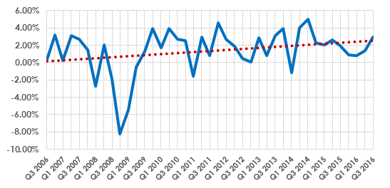
GDP Outlook
The overall positive U.S. GDP growth trend (as indicated by the dotted red line) indicates that the economy has gradually recovered from the 2008 financial crisis.
In Q3 of 2016, the real GDP increased by an annual rate of 2.9%. In all, personal consumption expenditures added 1.47 percentage points. This has been the strongest quarterly reading in two years, with previous quarters showing roughly 2% growth.
Percent Growth in GDP
Matthew Zimmer
Notes:
Matthew

Slide 9
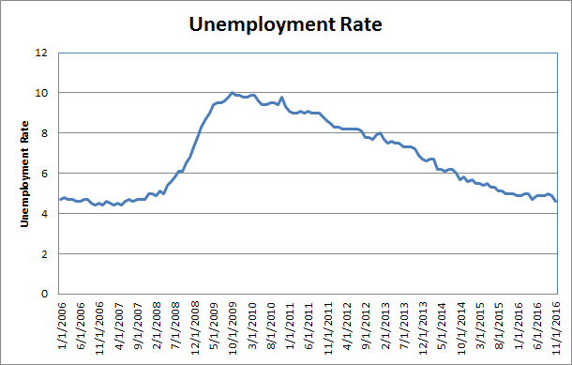
Unemployment
Unemployment rates are the lowest they have been since the recession
Since 2008, the labor force participation rate has fallen from 66.2% to 62.7%
While unemployment has fallen this is cancelled from the drop in labor force participation
Matthew Zimmer
Notes:
Matthew
Since real unemployment is roughly 10%, the Phillips Curve is inaccurate and inflation should be lower. By increasing interest rates, the effective inflation rate will decrease.

Slide 10
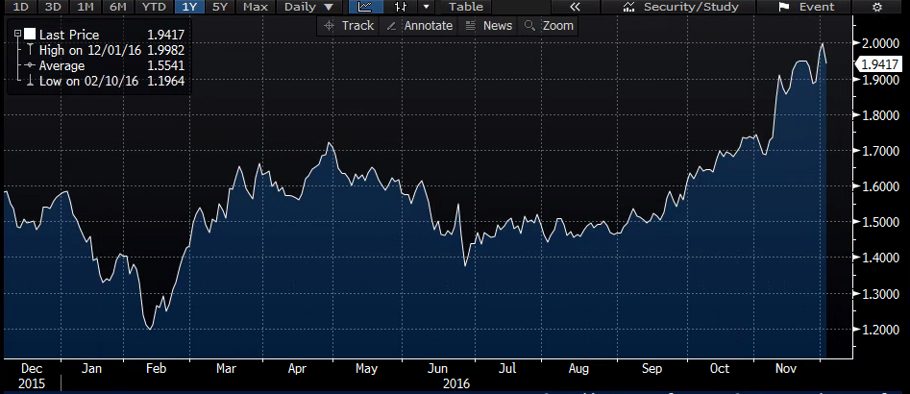
“Trumpflation”: 10 yr TIPS Breakevens
Tariffs
Wage Inflation
Fiscal stimulus (infrastructure)
Higher interest rates
Vincent Marzano
Notes:
Vincent

Slide 11
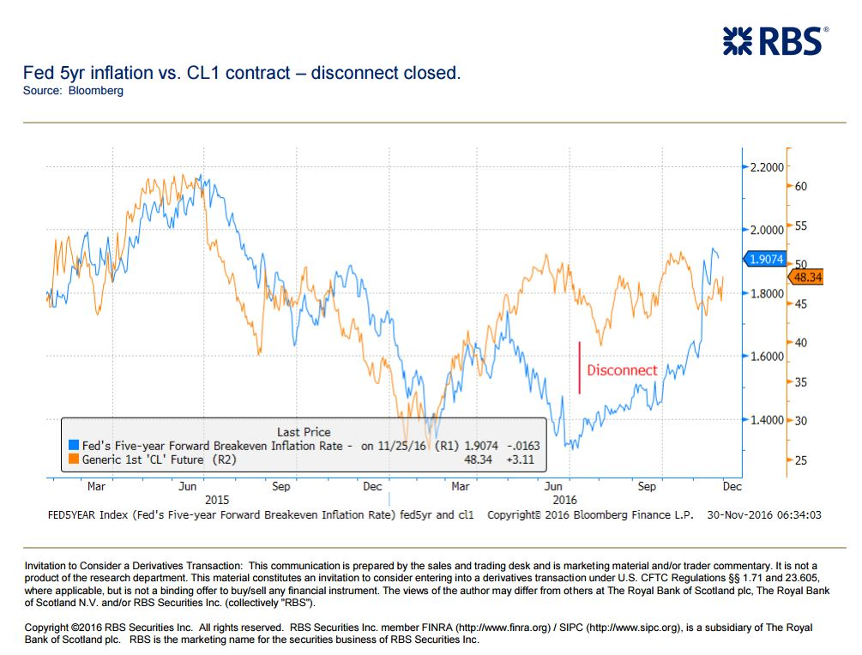
Moving in Tandem: Oil & Inflation
Why do oil and inflation exhibit a positive correlation?
Oil is more than gasoline; its an input into a wide array of businesses
The bottom line is always protected
OPEC reaches deal to cut production
Vincent Marzano
Notes:
Vincent

Slide 12
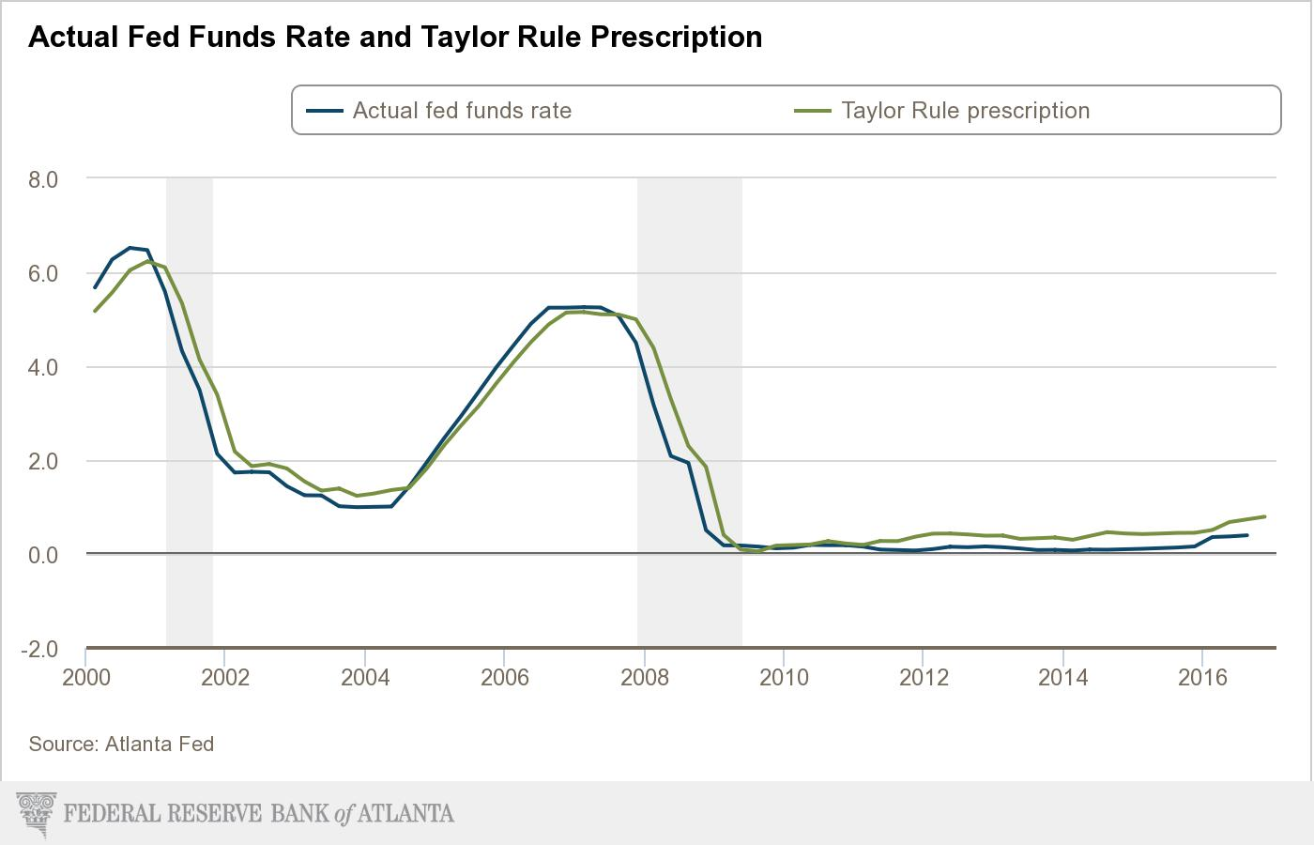
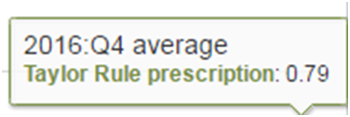

The Taylor Rule
Where…
πt is the inflation measure
π*t is the inflation target measure
r*t is the natural (real) interest rate measure
gapt is the resource gap measure
ρ is the interest-rate smoothing parameter
β is the weight on the resource gap
Vincent Marzano
Notes:
Vincent

Slide 13
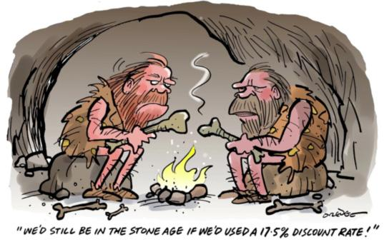
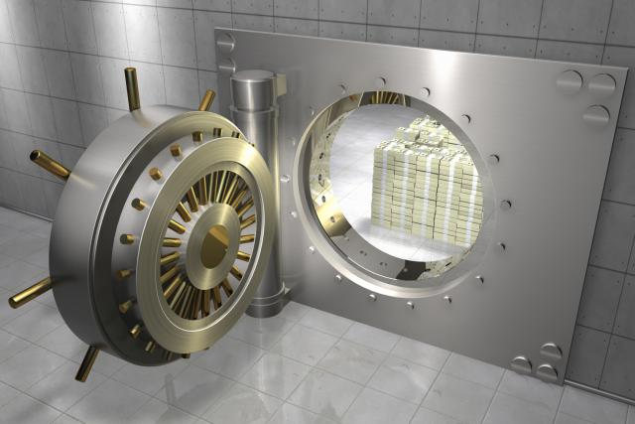
Monetary Tools
Federal Fund Rate
Discount Rate
Reserve Requirements
Increase Federal Fund Rate:
For the upcoming December meeting we would have the Federal Reserve raise the federal fund rate 25bps as planned. Long term we would like to see a more aggressive interest rate rise from the federal reserve
Increase Discount Rate:
For the upcoming december meeting raise the discount rate 25bps. Over time as the federal fund rate increases raise the discount rate.
Maintain Reserve Requirements:
An increase would cause uncertainty for banks
William McFarland
Notes:
Billy

Slide 14
Thank You For Your Time!

Slide 15
Articles
http://www.cnbc.com/2016/10/14/yellen-fed-might-want-to-run-a-high-pressure-economy.html
https://www.bloomberg.com/news/articles/2016-11-21/why-the-federal-reserve-must-become-the-world-s-dealer-of-last-resort
http://www.wsj.com/articles/why-the-fed-should-raise-rates-now-1475796011
https://www.bloomberg.com/news/articles/2016-11-16/what-a-trump-branded-federal-reserve-might-look-like
http://www.reuters.com/article/us-usa-economy-idUSKBN13P1OI

